Slide 1
Alcohol Intolerance (ALDH2)
Chris Stein
Notes:
https://www.ahajournals.org/doi/10.1161/ATVBAHA.119.312946 Important article for gap
https://www.ncbi.nlm.nih.gov/pmc/articles/PMC3684953/

Slide 2
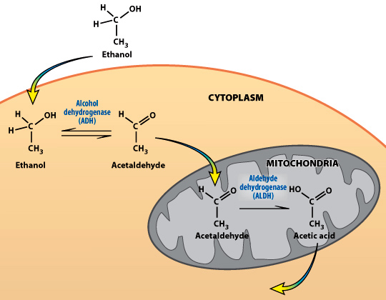
Alcohol metabolism

Slide 3
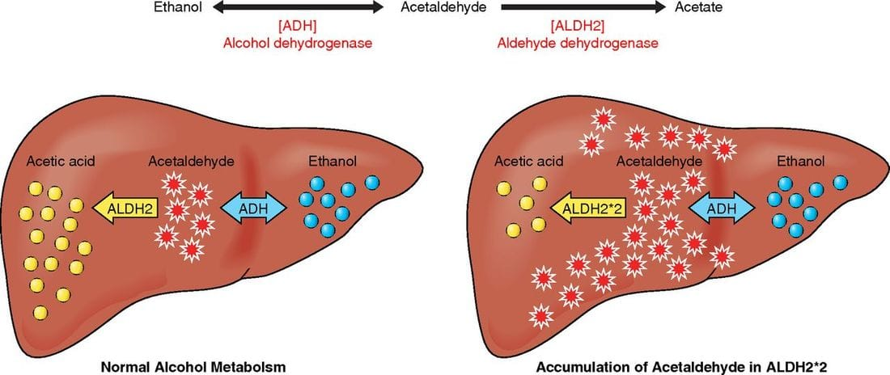
What is Alcohol Intolerance?
Notes:
https://www.thechhe.com/articles/alcohol-intolerance-the-cause-of-your-symptoms

Slide 4
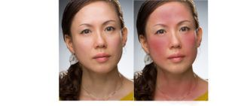
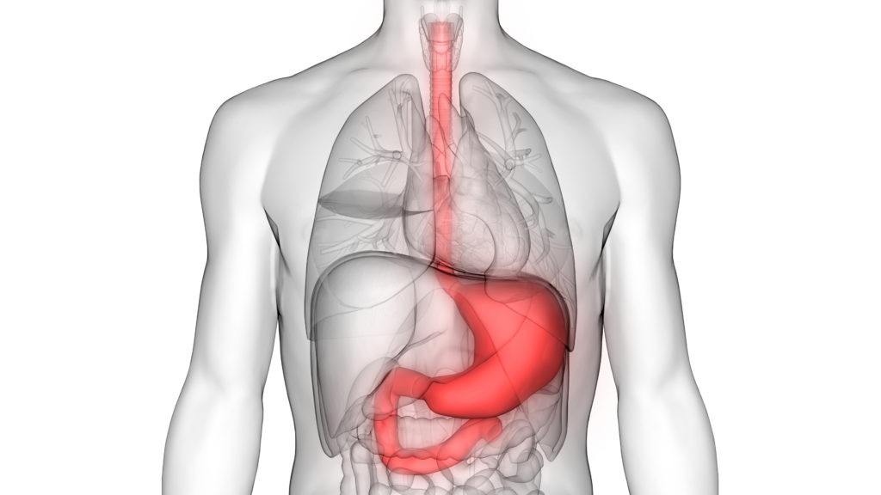
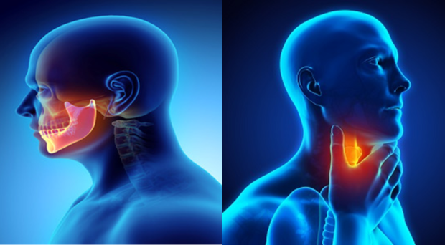
What are the symptoms of Alcohol Intolerance?
Notes:
https://www.saintjohnscancer.org/gastrointestinal/conditions-we-treat/stomach-and-esophagus-cancer/
https://blogs.biomedcentral.com/on-medicine/2019/04/08/oral-head-neck-cancer-awareness-month-research-highlights/

Slide 5
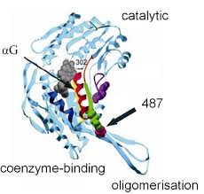
Mutation in ALDH2
480
SPFGGYQMSGSGREL
495
K
Liver
Notes:
Glutamine to Lysine

Slide 6
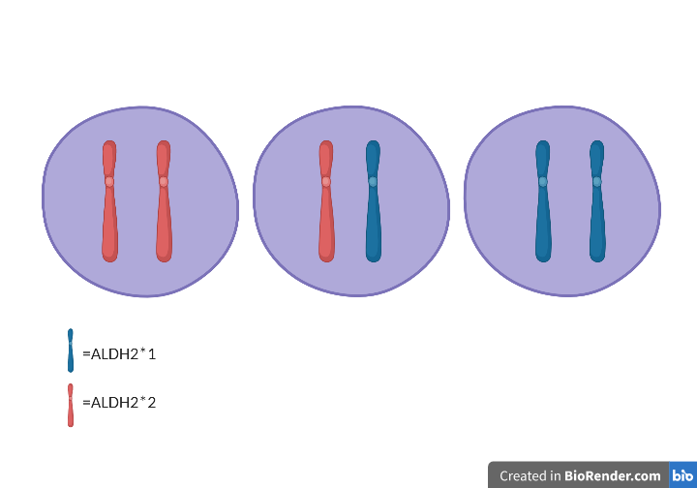
ALDH2 codominant expression
X6
Acetaldehyde
Metabolism
X19
Acetaldehyde
Metabolism

Slide 7
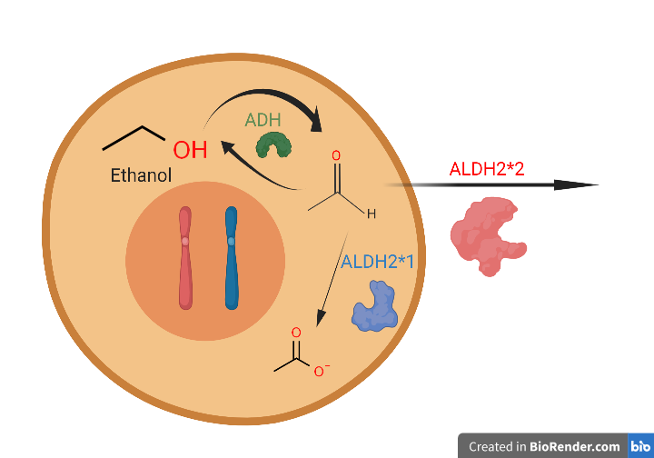
What do heterozygous ALDH2 mutants do with acetaldehyde?
Excess acetaldehyde and ethanol build up leading to:
DNA damage
Immune responses
Cell death

Slide 8
Do other proteins impact alcohol metabolism in homozygous mutants?

Slide 9
ALDH2 has one domain that assists with its main function of aldehyde dehydrogenase
Human
45
Aldedh
508
517 AA
Mouse
47
Aldedh
510
519 AA
Arabidopsis
66
Aldedh
528
538 AA
Drosophila
48
Aldedh
511
520 AA
C. elegans
42
Aldedh
505
514 AA
D. rerio
44
Aldedh
507
516 AA

Slide 10
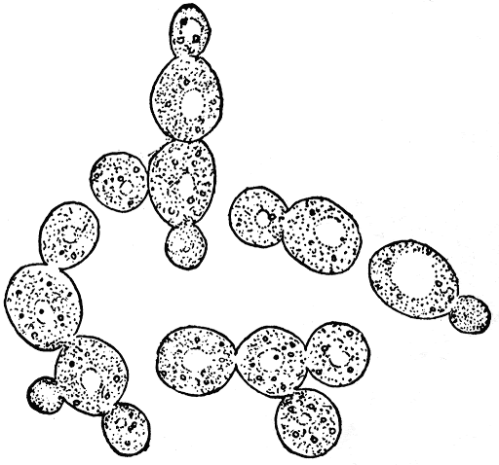
How are the ALDH2 homologs related?

Slide 11
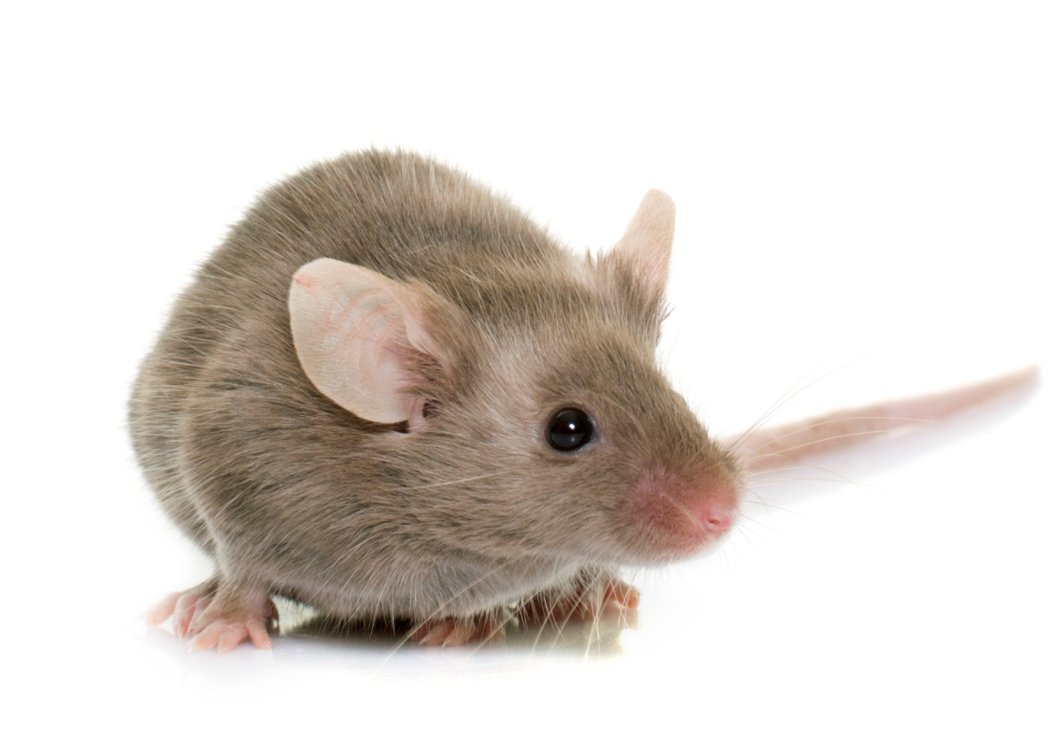
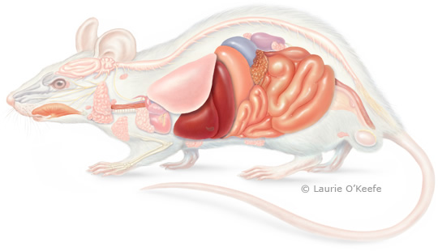
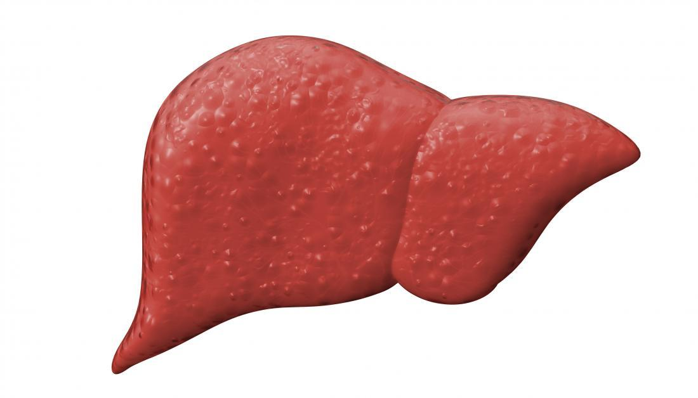
What model organism should be used?

Slide 12
Primary goal
To determine the role ALDH2 has outside of its role in alcohol metabolism.
Aim 1: Determine how mutations in aldedh domain affect ALDH2 activity.
Aim 2: Identify differentially expressed genes across liver development in mice.
Aim 3: Characterize novel protein interactions important for liver development

Slide 13
Aim 1: Determine conserved amino acids essential for ALDH2 function
Clustal Omega
Screening
CRISPR/ Cas 9

Slide 14
Aim 1: Determine conserved amino acids essential for ALDH2 function
Functional ALDH2
Non-functional ALDH2
Clustal Omega
Screening
CRISPR/ Cas 9

Slide 15
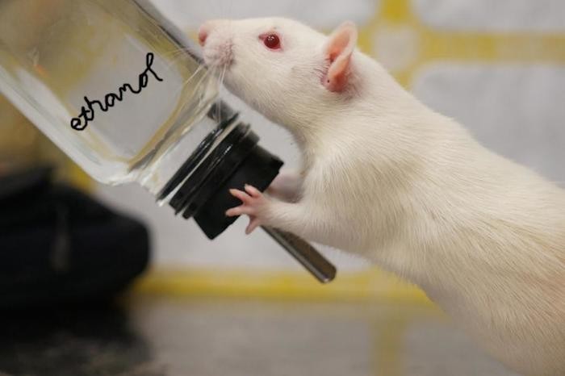
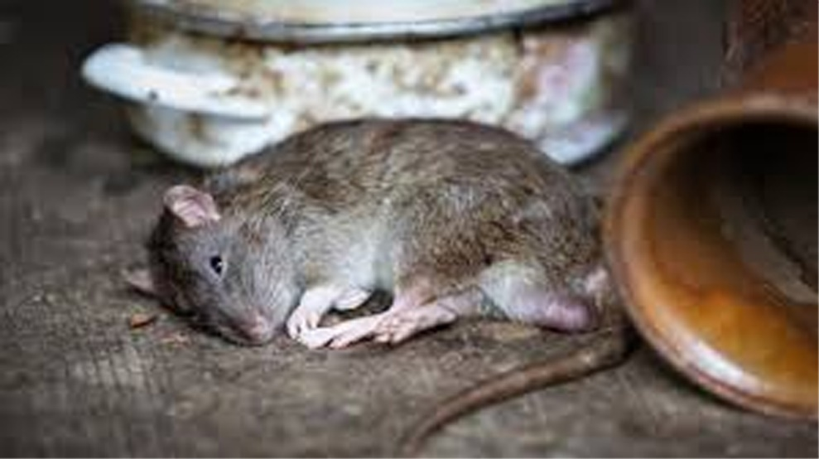
Aim 1: Determine conserved amino acids essential for ALDH2 function
Clustal Omega
Screening
CRISPR/ Cas 9
Notes:
https://www.soberinfo.com/mouse-study-fathers-pre-conception-alcohol-consumption-influence-son/
https://www.dailyexcelsior.com/new-marker-helps-predict-mice-prone-to-alcohol-addiction-study/

Slide 16
Aim 2: What genes are differentially expressed in ALDH2 mutants?
WT
ALDH2 mutant
RNA-seq
GO
Pathway analysis

Slide 17
Aim 2: What genes are differentially expressed in ALDH2 mutants?
WT
ALDH2 mutant
RNA-seq
GO
Pathway analysis

Slide 18
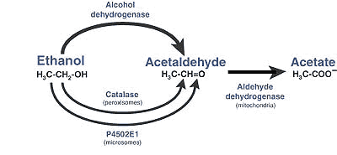
Aim 2: What genes are differentially expressed in ALDH2 mutants?
RNA-seq
GO
Pathway analysis

Slide 19
Aim 3: What other proteins interact with ALDH2?
WT
ΔALDH2
Bio-ID
IP and MS
Compare interactions

Slide 20
Aim 3: What other proteins interact with ALDH2?
Bio-ID
Digestion and MS
Compare interactions

Slide 21
Aim 3: What other proteins interact with ALDH2?
WT
ΔALDH2
Bio-ID
IP and MS
Compare interactions

Slide 22
References
https://www.thechhe.com/articles/alcohol-intolerance-the-cause-of-your-symptoms
https://www.saintjohnscancer.org/gastrointestinal/conditions-we-treat/stomach-and-esophagus-cancer/
https://blogs.biomedcentral.com/on-medicine/2019/04/08/oral-head-neck-cancer-awareness-month-research-highlights/

