Slide 1
Alcohol Intolerance (ALDH2)
Chris Stein

Slide 2
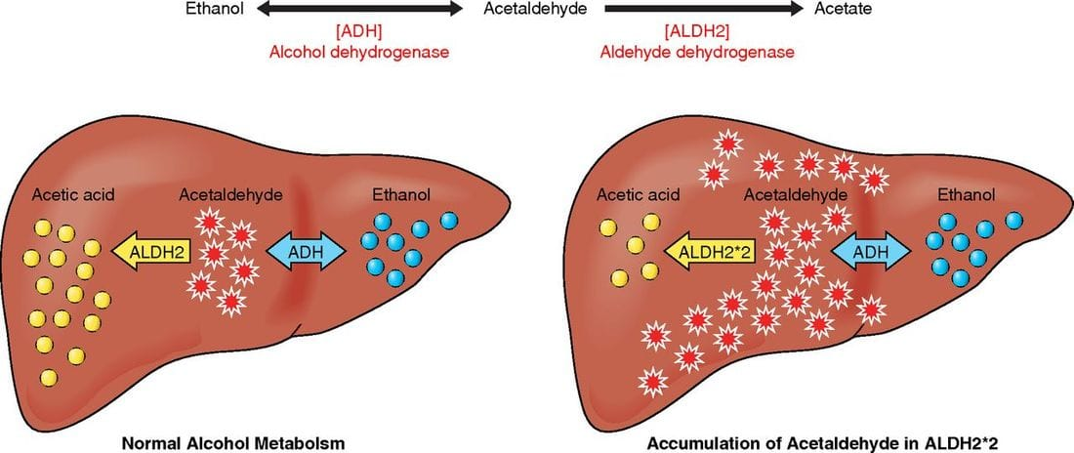
What is Alcohol Intolerance?
Notes:
https://www.thechhe.com/articles/alcohol-intolerance-the-cause-of-your-symptoms

Slide 3
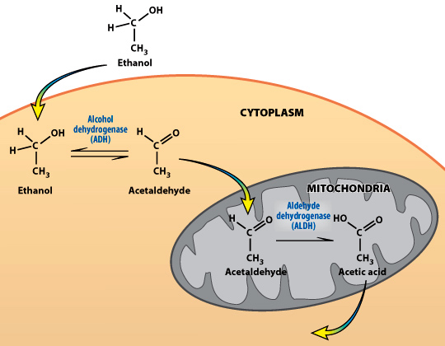
Alcohol metabolism

Slide 4
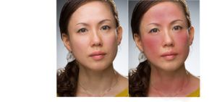
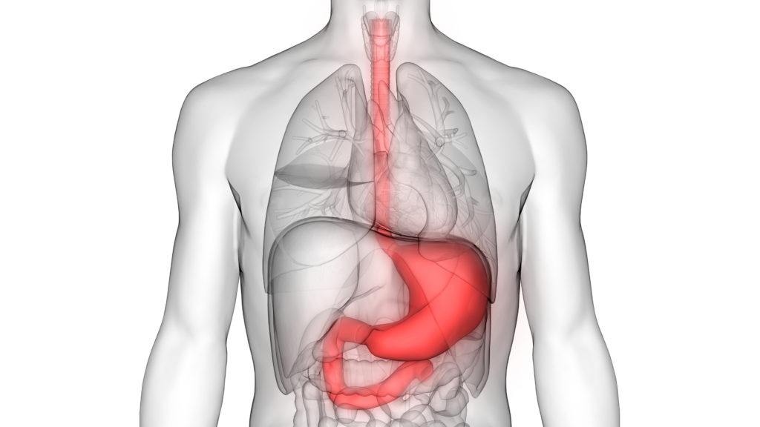
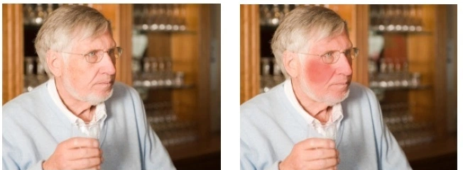
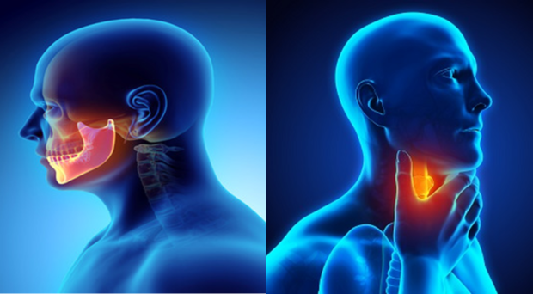
What are the symptoms of Alcohol Intolerance?
Notes:
https://www.saintjohnscancer.org/gastrointestinal/conditions-we-treat/stomach-and-esophagus-cancer/
https://blogs.biomedcentral.com/on-medicine/2019/04/08/oral-head-neck-cancer-awareness-month-research-highlights/

Slide 5
Mutation in ALDH2
480
SPFGGYKMSGSGREL
495
Notes:
Glutamine to Lysine

Slide 6
ALDH2 codominant expression
x6
x19
A
A
A
G
G
G
In the individuals who are heterozygous and homozygous for the G allele the acetaldehyde levels are higher.

Slide 7
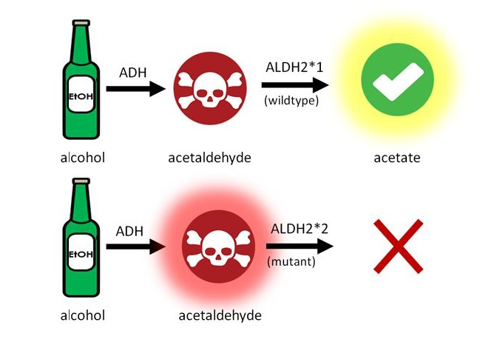
What do homozygous ALDH2 mutants do with acetaldehyde?
A
A
A
G
G
G

Slide 8
Do other proteins impact alcohol metabolism in homozygous mutants?

Slide 9
ALDH2 has one domain that assists with its main function of aldehyde dehydrogenase
Human
45
Aldedh
508
517 AA
Mouse
47
Aldedh
510
519 AA
Arabidopsis
66
Aldedh
528
538 AA
Drosophila
48
Aldedh
511
520 AA
C. elegans
42
Aldedh
505
514 AA
D. rerio
44
Aldedh
507
516 AA

Slide 10
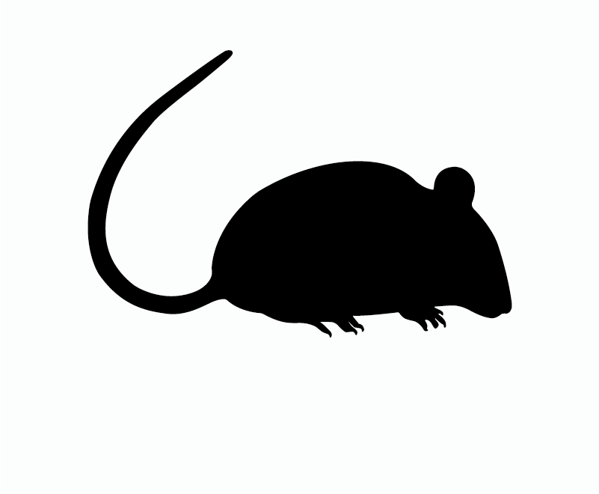
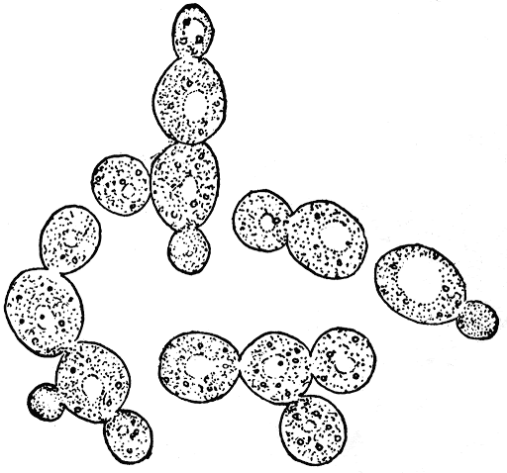
How are the ALDH2 homologs related?

Slide 11
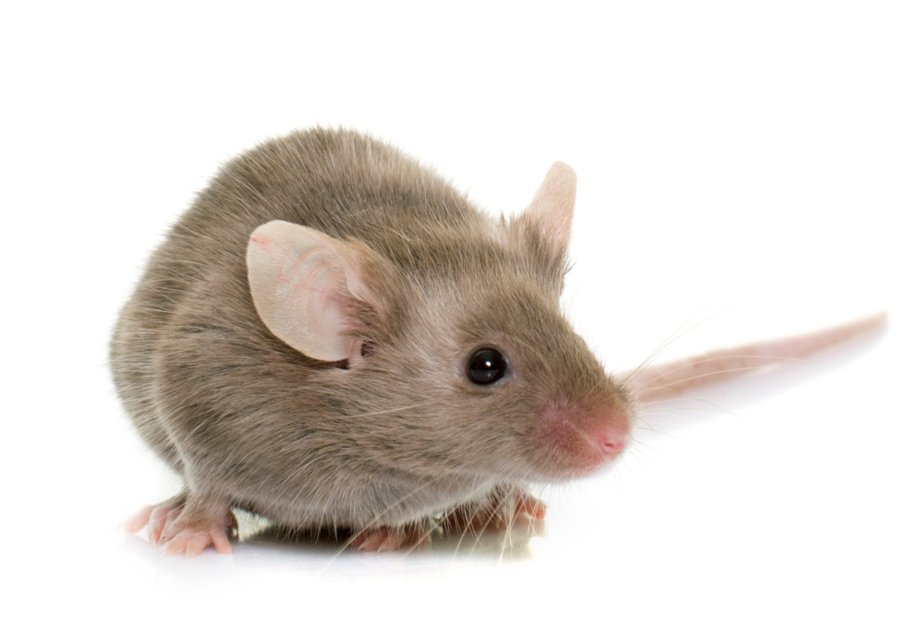
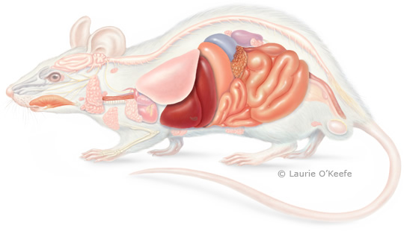
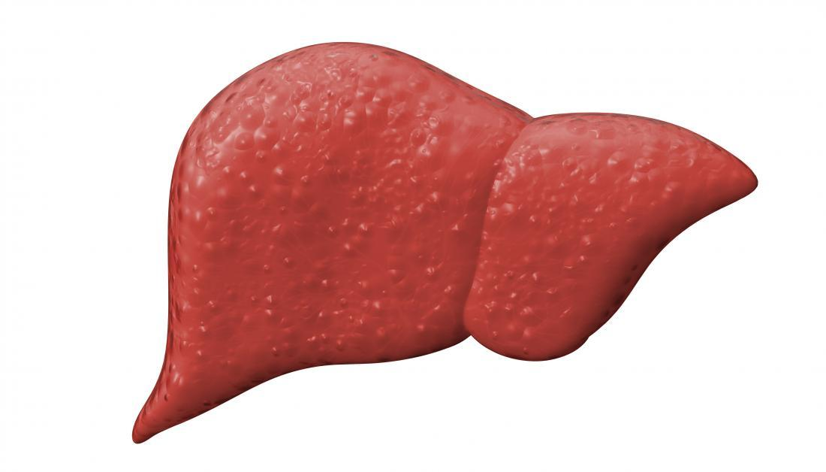
What model organism should be used?

Slide 12
Primary goal
To determine alternative genes that can assist in the metabolization intermediates in the ethanol metabolism pathway.

Slide 13
References
https://www.thechhe.com/articles/alcohol-intolerance-the-cause-of-your-symptoms
https://www.saintjohnscancer.org/gastrointestinal/conditions-we-treat/stomach-and-esophagus-cancer/
https://blogs.biomedcentral.com/on-medicine/2019/04/08/oral-head-neck-cancer-awareness-month-research-highlights/

